Slide 1
ViFi : VISION FIEDELITY
TIC TECH TOE 2018 @ DAIICT-GANDHINAGAR
THEME: EDTECH-Technological Breakthrough In Education
GROUP MEMBERS of TEAM S.A.F.A.R-J.A.N
ZEAL PATEL
ALOKENDU MAZUMDER
ASTHA SHRIVASTAV
RAVI PAMBHAR
PRATIMA MOHAN

Slide 2
index
DEFINING THE PROBLEM SCENARIO
PROBLEM STATEMENT
SOCIAL IMPACT
WORKING ALGORITHM
FUTURE ASPECTS
ADVANTAGES
APPENDIX: SURVEY

Slide 3
Defining the problem SCENARIO
& AIM
Students living in rural area, don’t have enough access to free E-books and digital learning materials due to lack to internet access and smartphone ownership.
AIM of this project is to distribute digital learning resources to rural areas where internet connectivity & smartphone ownership is near zero in such a way that the students living there can access these resources without depending on internet connectivity and smartphones.

Slide 4
Problem statement
Kids in Rural Areas face immense difficulties in getting good education owing to the lack of resources like money, access to good facilities, low reach of technology and many more. Can you put in some efforts and help these kids secure better educational facilities? If yes, develop an app that facilitates education among the rural kids. A small step of yours can make a big difference.

Slide 5
Overview & Social impact
From the surveys(given at end slides) we've noticed that there are still places in India where internet connectivity and smartphones are not in use, but TV are present in almost every home.
In such places students cannot get enough educational resources. In extreme rural areas where only simple cell phones and TV are there in family, children might not get good quality books and digital learning resources for study.
WHAT ViFi can do to solve this ?
With this technology, during commercials of government programs or educational programs or in channels like DD national or any other educational channels, a stream of QR codes containing necessary E-books and learning resources will be flashed on the bottom corner of TV.
Hence, by using a simple cell phone with camera above 5 MP and that can support PDF, DOCX or TXT formats, student can fetch/receive the resources from TV directly, by just facing their phone’s camera to the QR codes.

Slide 6
Working algorithm
File which is to be transmitted is converted into DATA URL
That DATA URL in converted into string
The length of string is then calculated and that string is divided in smallest possible set which is required to make a complete QR code.
Hence depending on the size of files, number of QR codes are generated, in simple ways a complete file is divided uniformly among several QR codes.
Another special QR code is generated which contains information like, name of file, size of file, the number of QR codes generated and etc.
Each QR code contains a unique header which is essential to specify its position among all QR codes.

Slide 7
Working algorithm (contd…)
As the file is completely transformed into QR codes, the number of QR codes will start flashing at the sender’s screen.
On the other hand the receiver will flash device’s camera to the flashing QR codes to receive the incoming data.
The receiver will perform the reverse action and will stich all the data of QR code into a single predefined file format.

Slide 8
advantages
Transfer of data doesn't require internet, hotspot or Bluetooth connectivity.
Can be accessed from extreme rural areas.
Can transfer any extension of data.
Only requirement is, User must have color TV and cellphone having camera 5.0MP and can support docx or pdf or txt format files.
Easy data transfer.

Slide 9
Future aspects
Will increase the data transfer speed
Plans to distribute LARGE & HIGH QUALITY VIDEO resources also via this technology.

Slide 10
Survey
APPENDIX
Sources:
CNN Network
The Hindu

Slide 11
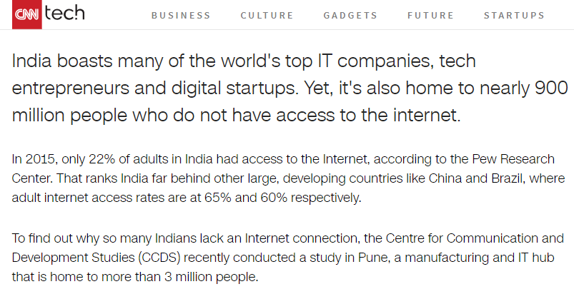
900 million Indians can't get online. Here's why !

Slide 12
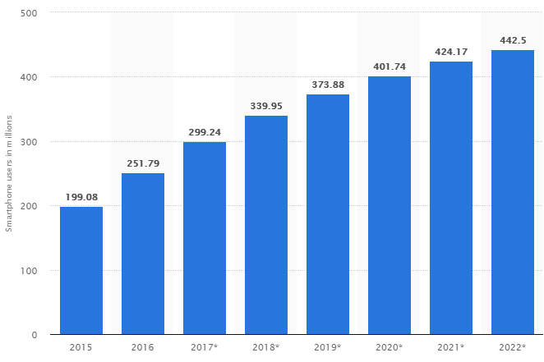
No of Smartphone users in in India from 2015 – 2022 (expected)

Slide 13
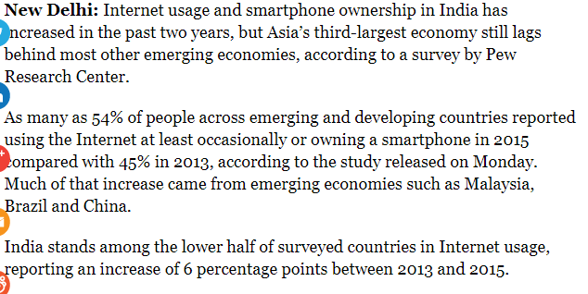
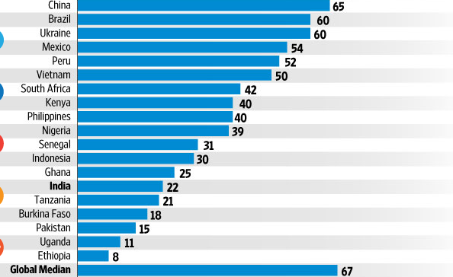
Internet Usage and Smartphone ownership in INDIA

Slide 14
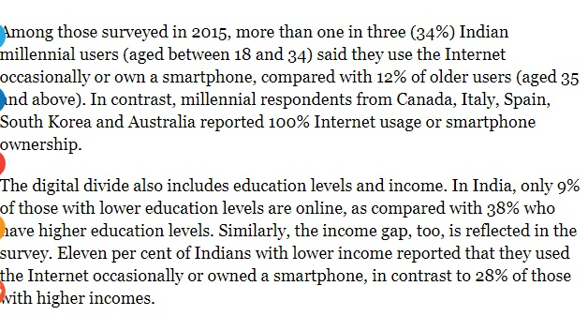
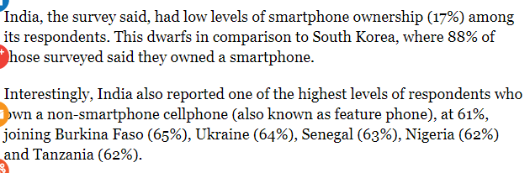
Internet Usage and Smartphone ownership in INDIA

Slide 15
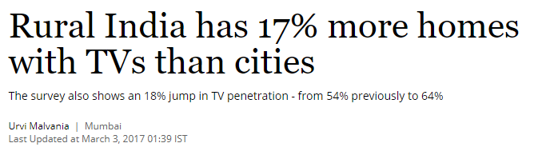
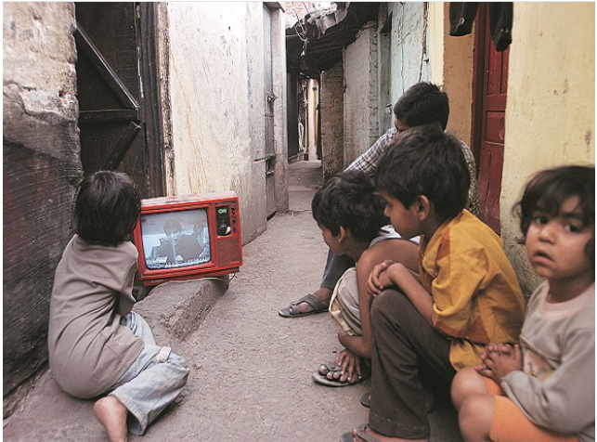

Slide 16
THANK YOU !

